Slide 1

WELCOME

Slide 2
Supervised by
==========
Group memer:
Najib Mahfuj 22-48248-2
Jerin jaman 22-67340-2
Project : DRESS
HOUSE
Supervised by
==========
Group memer:
Najib Mahfuj 22-48248-2
Jerin jaman 22-67340-2

Slide 3
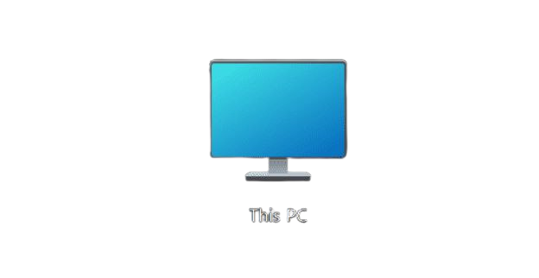

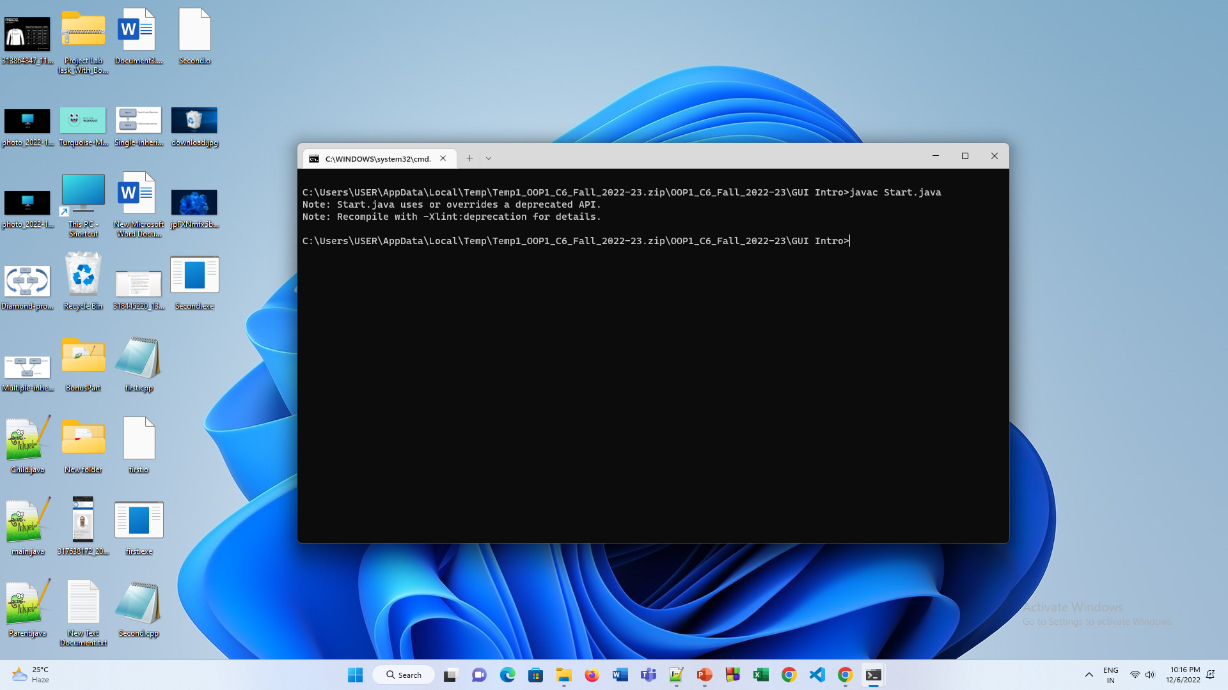
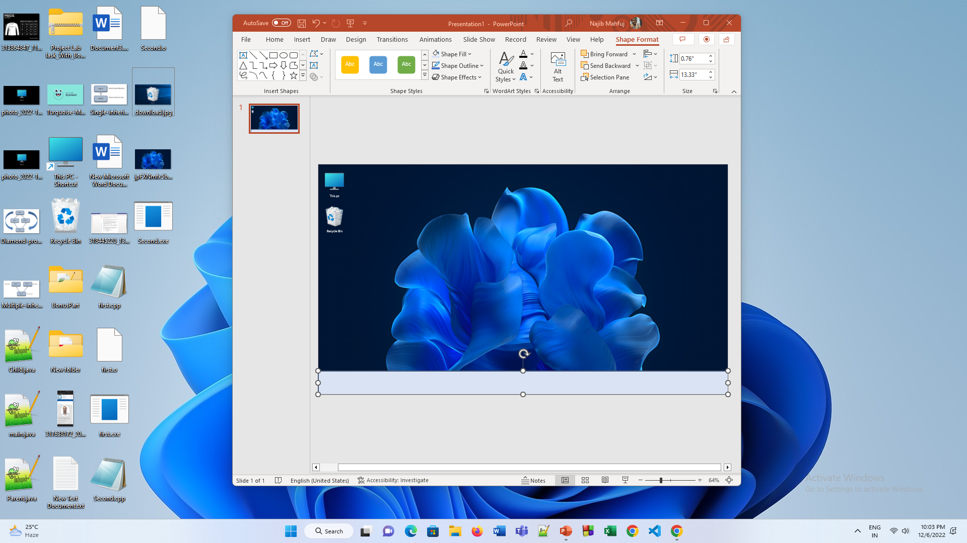
This pc
Recycle Bin
java Start

Slide 4
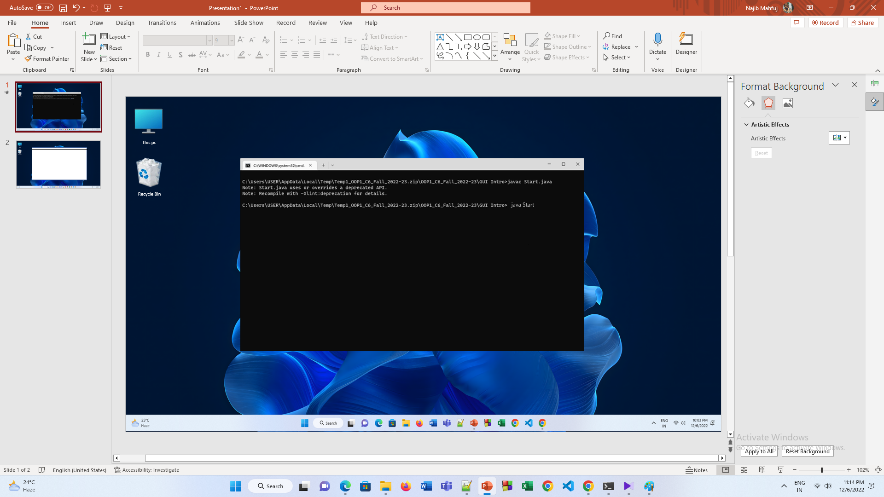

DRESS HOUSE
USERNAME
PASSWORD
LOGIN
Registration?

Slide 5
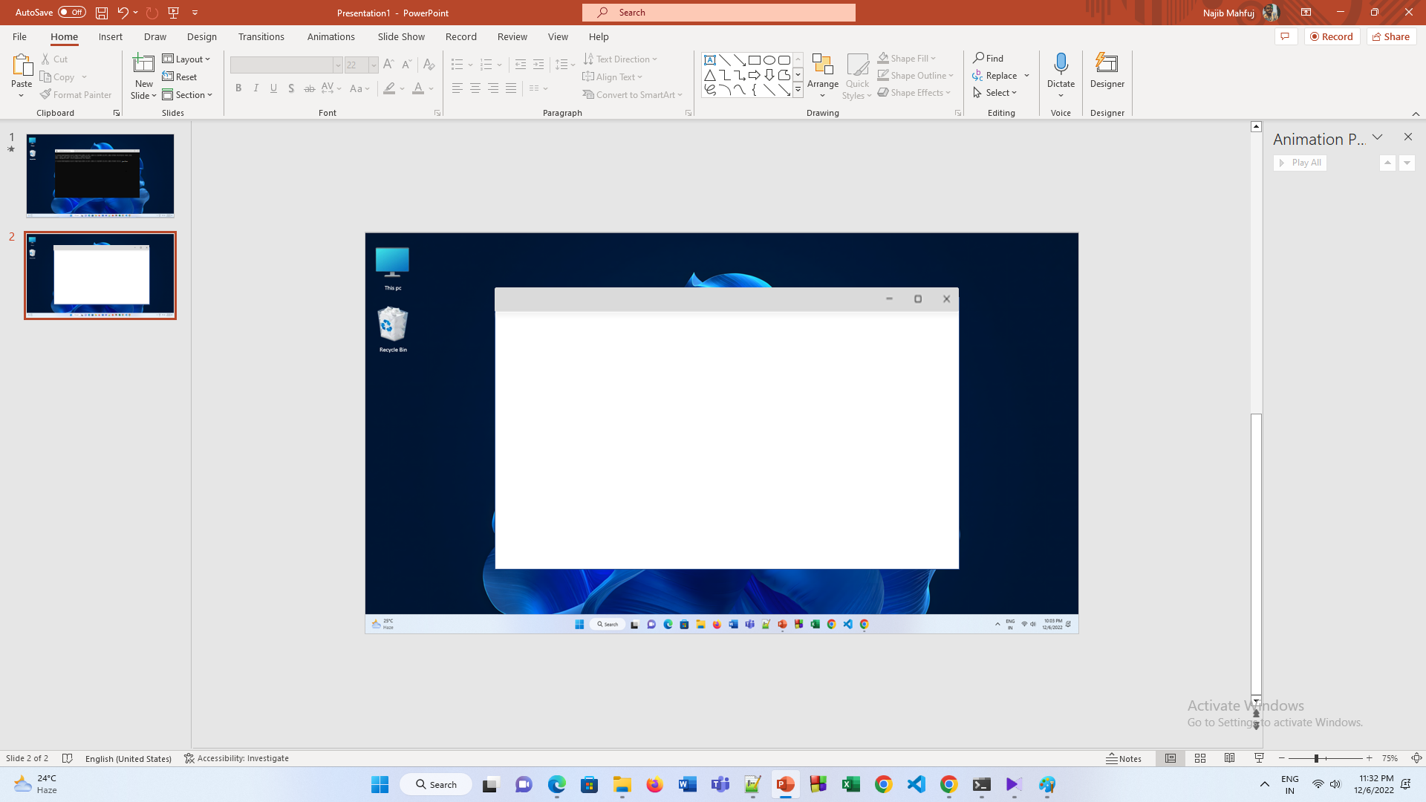
REGISTRATION
Name
Najib Mahfuj
PASSWORD
######
CONFIRM PASSWORD
######
MOBILE NO
01734373827
SIGN UP

Slide 6
CLOTHE HOUSE
USERNAME
Najib Mahfuj
PASSWORD
######
LOGIN
Registration?

Slide 7
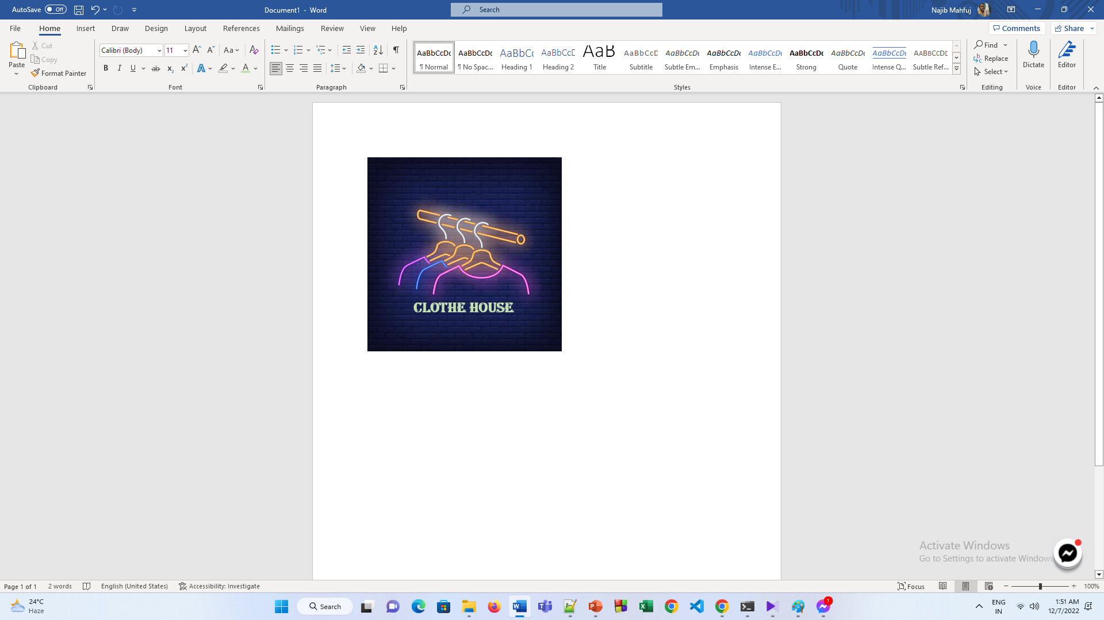


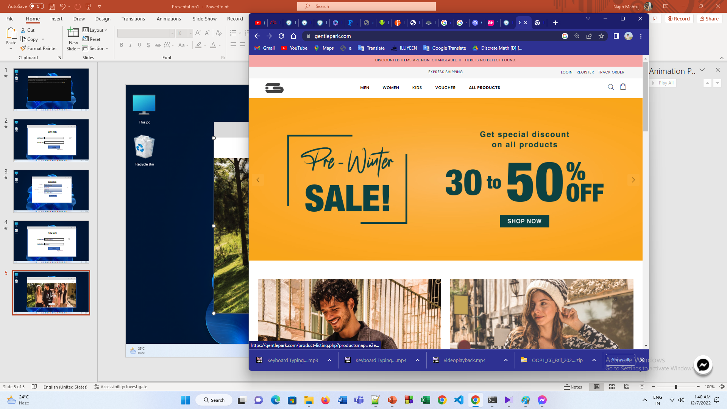
MEN
WOMEN
CHILD
Women and Child cloth coming soon

Slide 8
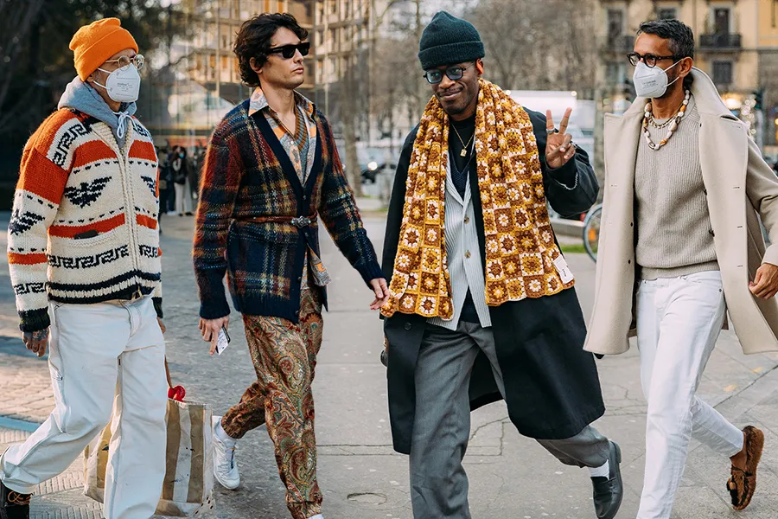
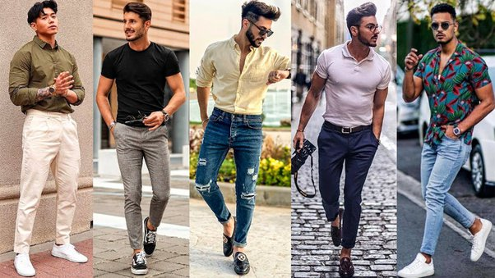
MEN
WOMEN
CHILD
Coming soon
Winter
Summer

Slide 9
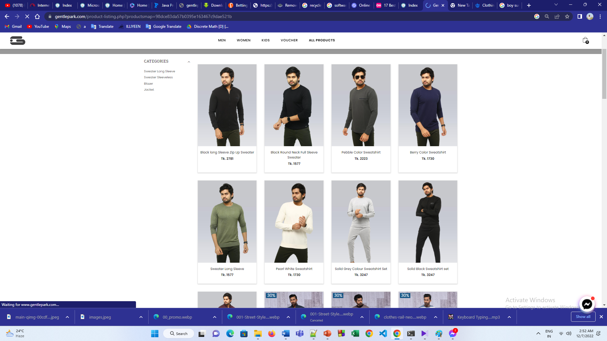
MEN
WOMEN
CHILD

Slide 10
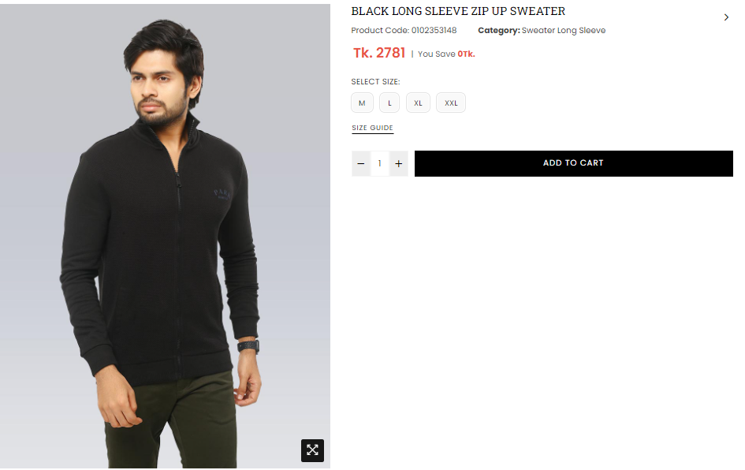
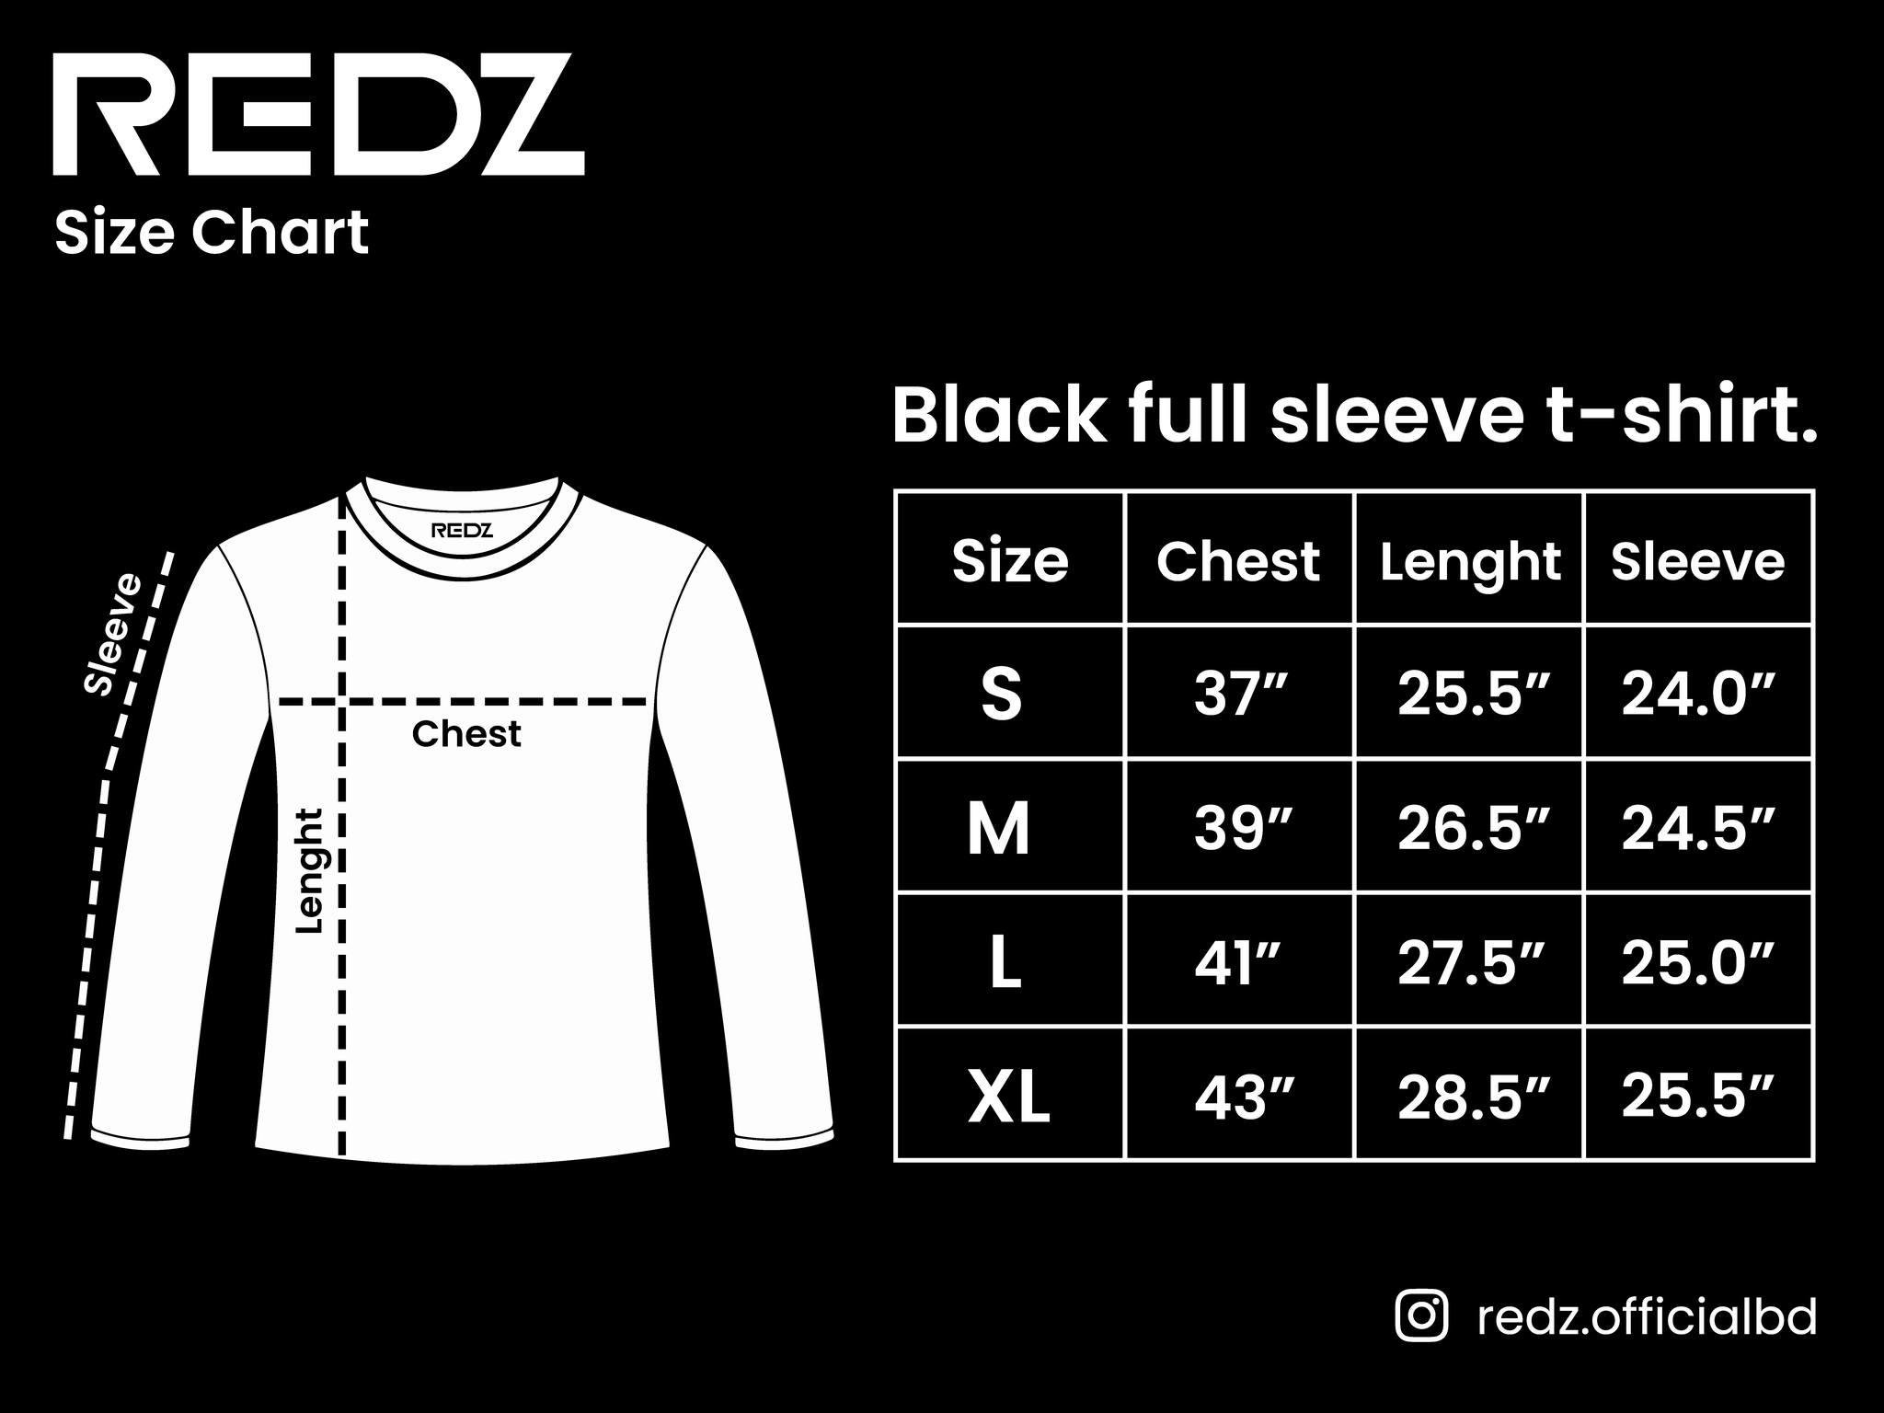
MEN
WOMEN
CHILD
PAYMENT
Dress
House

Slide 11



DF
MEN
WOMEN
CHILD
PAYEMENT
Mobile No
01744149659
Verify code
55757
Confirm
Payment Successful

